Slide 1

Chapter 7
Internet Protocol Version4
(IPv4)
Copyright © The McGraw-Hill Companies, Inc. Permission required for reproduction or display.

Slide 2

Network Layer Services
At
Source
Intermediate Devices
Destination
Source
Intermediate Devices
Destination
Notes:
Network Layer Services-
At Sender, Intermediate Devices & Receiver

Slide 3
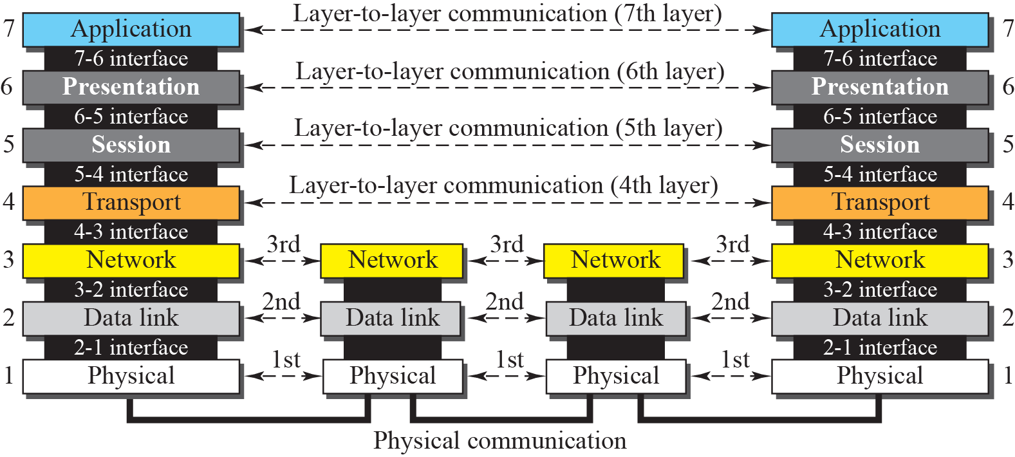
Recall layers at –Source, Intermediate devices & Destination
Source
Intermediate Devices
Destination
Notes:
Recall layers at –Source, Intermediate devices & Destination

Slide 4
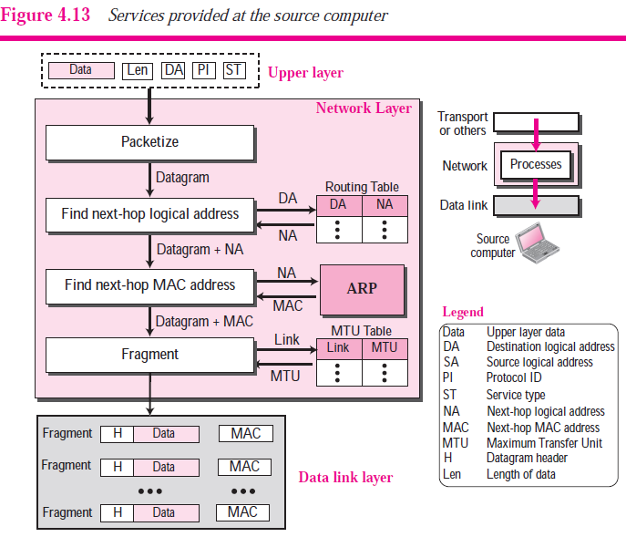
At Source- Packetizing & Fragmentation
Notes:
Services Provided at the Source Computer
The network layer receives several pieces of information from the upper layer:
data, length of data, logical destination address, protocol ID (the identifier of the protocol
using the network layer), and service type (discussed later). The network layer
processes these pieces of information to create a set of fragmented datagrams and the
next-hop MAC address and delivered them to the data link layer.
Packetizing
The first duty of the network layer is to encapsulate the data coming from the upper
layer in a datagram. This is done by adding a header to the data that contains the logical
source and destination address of the packet, information about fragmentation, the protocol
ID of the protocol that has requested the service, the data length, and possibly
some options. The network layer also includes a checksum that is calculated only over
the datagram header.
Finding Logical Address of Next Hop
The prepared datagram contains the source and destination addresses of the packet. The
datagram, as we saw before, may have to pass through many networks to reach its final
destination. If the destination computer is not connected to the same network as the
source, the datagram should be delivered to the next router. The source and destination
address in the datagram does not tell anything about the logical address of the next hop.
The network layer at the source computer needs to consult a routing table to find the
logical address of the next hop.
Finding MAC Address of Next Hop
The network layer does not actually deliver the datagram to the next hop; it is the duty
of the data link layer to do the delivery. The data link layer needs the MAC address of
the next hop to do the delivery. To find the MAC address of the next hop, the network
layer could use another table to map the next-hop logical address to the MAC address.
However, for the reason we discuss in Chapter 8, this task has been assigned to another
auxiliary protocol called Address Resolution Protocol (ARP) that finds the MAC
address of the next hop given the logical address.
Fragmentation
The datagram at this step may not be ready to be passed to the data link layer. As we
saw in Chapter 3, most LANs and WANs have a limit on the size of the data to be carried
in a frame (MTU). The datagram prepared at the network layer, may be larger than
that limit. The datagram needs to be fragmented to smaller units before being passed to
the data link layer. Fragmentation needs to preserve the information at the header of the
datagram. In other words, although the data can be fragmented, the header needs to
be repeated. In addition, some more information needs to be added to the header to
define the position of the fragment in the whole datagram.

Slide 5
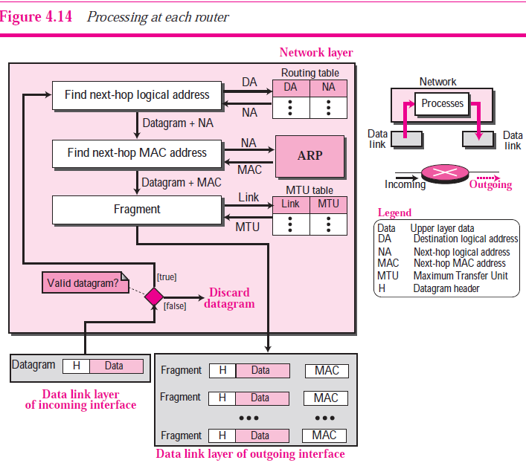
At Intermediate Devices- Fragmentation & Packetizing
Notes:
A router is involved with two interfaces with respect to a
single datagram: the incoming interface and the outgoing interface. The network layer
at the router, therefore, needs to interact with two data link layers: the data link of the
incoming interface and the data link layer of the outgoing interface. The network layer
is responsible to receive a datagram from the data link layer of the incoming interface,
fragment it if necessary, and deliver the fragments to the data link of the outgoing interface.
The router normally does not involve upper layers (with some exceptions discussed
in future chapters). Figure 4.14 shows the services provides by a router at the
network layer.
The three processes (finding next-hop logical address, finding next-hop MAC
address, and fragmentation) here are the same as the last three processes mentioned for
a source. Before applying these processes, however, the router needs to check the validity
of the datagram using the checksum (see Chapter 7). Validation here means that the
datagram header is not corrupted and the datagram is delivered to the correct router.

Slide 6
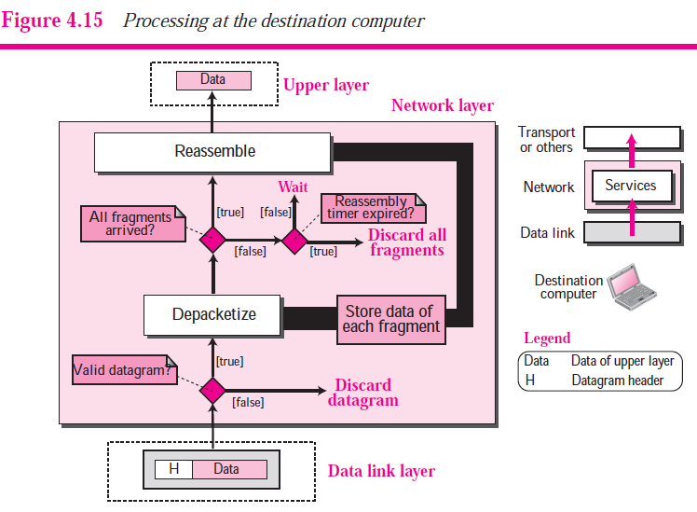
At Destination- Reassembly
Notes:
The network layer at the destination computer is simpler. No forwarding is needed.
However, the destination computer needs to assemble the fragments before delivering
the data to the destination. After validating each datagram, the data is extracted from
each fragment and stored. When all fragments have arrived, the data are reassembled
and delivered to the upper layer. The network layer also sets a reassembly timer. If the
timer is expired, all data fragments are destroyed and an error message is sent that all
the fragmented datagram need to be resent. Figure 4.15 shows the process. Note that the
process of fragmentation is transparent to the upper layer because the network layer
does not deliver any piece of data to the upper layer until all pieces have arrived and
assembled. Since a datagram may have been fragmented in the source computer as well
as in any router (multilevel) fragmentation, the reassembly procedure is very delicate
and complicated.

Slide 7
OBJECTIVES:
To explain the general idea behind the IP protocol and the position of IP in TCP/IP protocol suite.
To show the general format of an IPv4 datagram.
To discuss fragmentation and reassembly of datagrams.
To discuss several options that can be in an IPv4 datagram and their applications.
To show how a checksum is calculated for the header of an IPv4 datagram at the sending site and how the checksum is checked at the receiver site.

Slide 8
Chapter Outline
7.1 Introduction
7.2 Datagrams
7.3 Fragmentation
7.4 Options
7.5 Checksum

Slide 9
7-1 INTRODUCTION
The Internet Protocol (IP) is the transmission mechanism used by the TCP/IP protocols at the network layer.

Slide 10
Topics Discussed in the Section
Relationship of IP to the rest of the TCP/IP Suite

Slide 11
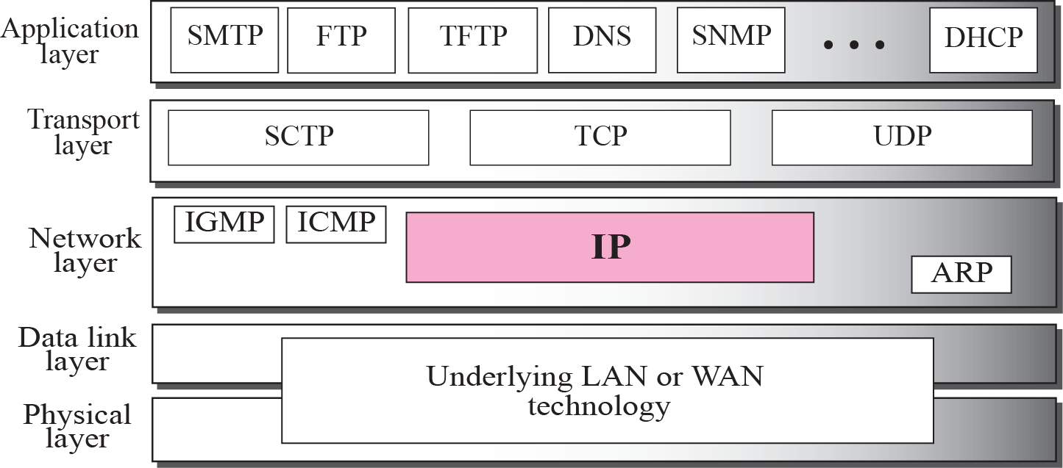
Figure 7.1 Position of IP in TCP/IP protocol suite
Notes:
IP is an unreliable and connectionless datagram protocol—a best-effort delivery
service. The term best-effort means that IP packets can be corrupted, lost, arrive out of
order, or delayed and may create congestion for the network.
By unreliable we mean there are no guarantees that an IP datagram successfully gets to its destination.
If reliability is important, IP must be paired with a reliable protocol such as TCP.
An example of a more commonly understood best-effort delivery service is the post
office. The post office does its best to deliver the mail but does not always succeed. If
an unregistered letter is lost, it is up to the sender or would-be recipient to discover the
loss and rectify the problem. The post office itself does not keep track of every letter
and cannot notify a sender of loss or damage.
IP is also a connectionless protocol for a packet switching network that uses the
datagram approach. This means that each datagram is handled independently,
and each datagram can follow a different route to the destination. This implies
that datagrams sent by the same source to the same destination could arrive out of
order. Also, some could be lost or d during transmission. Again, IP relies on a
higher-level protocol to take care of all these corruptee problems.

Slide 12
7-2 DATAGRAMS
Packets in the network (internet) layer are called datagrams.
A datagram is a variable-length packet consisting of two parts: header and data.
The header is 20 to 60 bytes in length and contains information essential to routing and delivery.
It is customary in TCP/IP to show the header in 4-byte(32 bit) sections.
A brief description of each field is in order.

Slide 13
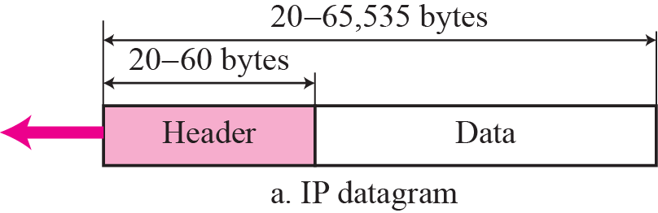
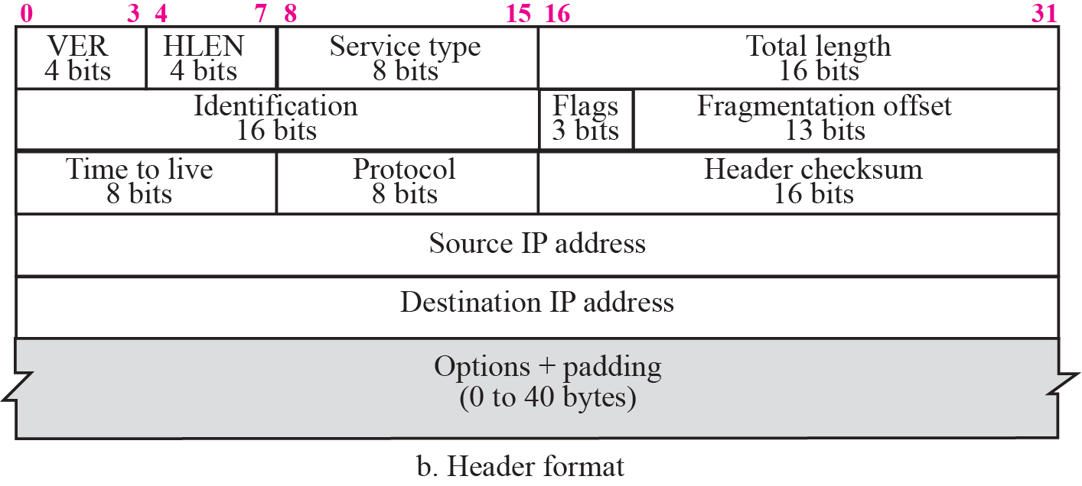
Figure 7.2 IP datagram
4500 003c 1c46 4000 4011 0B19 9912 0869 AC02 0E0A
HLEN 20 bytes Base Header (mandatory header) and
the value of this field is 5 (5 × 4= 20)
Notes:
In figure- till end of destination address , it is 120 bits (32* 5 rows in fig) means 20 bytes (mandatory header). Header may be extended upto 60 bytes depending on Options part added
Version (VER). This 4-bit field defines the version of the IP protocol. Currently the version is 4 means 0100₂. However, version 6 (or IPv6) may totally replace version 4 in the
future. This field tells the IP software running in the processing machine that the datagram has the format of version 4. All fields must be interpreted as specified in the fourth version of the protocol. If the machine is using some other version of IP, the datagram is discarded rather than interpreted incorrectly.
Header length (HLEN). This 4-bit field defines the total length of the datagram header in 4-byte words. This field is needed because the length of the header is
variable (between 20 and 60 bytes). When there are no options, the header length is 20 bytes, and the value of this field is 5 (5× 4= 20). When the option field is at
its maximum size, the value of this field is 15 (15× 4= 60).

Slide 14
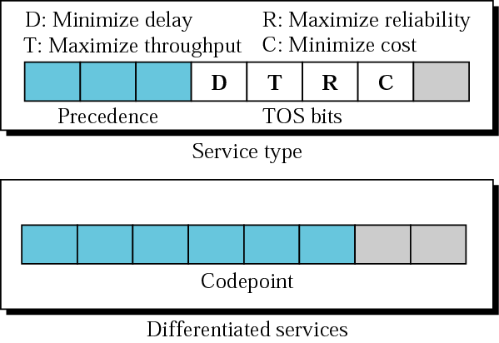
Service type or differentiated services
In the original design of IP header Service Type(8-bits) defined as –Precedence & TOS Bits
Latter IETF has changed Service Type(8-bits) to Differentiated Service
Notes:
Differentiated Service- mechanism for classifying and managing network traffic and providing quality of service.
Differentiated Services Definition
Differentiated Services is a multiple service model that can satisfy differing QoS requirements. With Differentiated Services, the network tries to deliver a particular kind of service based on the QoS specified by each packet. This specification can occur in different ways, for example, using the 6-bit differentiated services code point (DSCP) setting in IP packets or source and destination addresses. The network uses the QoS specification to classify, mark, shape, and police traffic and to perform intelligent queueing.
Table 2 DSCP Values for Traffic Classes and Traffic Types
Traffic Class Traffic Type DSCP Value
Premium Voice 46
Gold TACACS 10
Silver Telnet 18
SMTP 20
FTP 22
Bronze HTTP 26
TACACS- Terminal Access Controller Access-Control System (TACACS, /ˈtækæks/) refers to a family of related protocols handling remote authentication and related services for networked access control through a centralized server.
Using packet classification, you can partition network traffic into multiple priority levels or classes of service. When traffic descriptors are used to classify traffic, the source agrees to adhere to the contracted terms and the network promises a QoS. Traffic policers and traffic shapers use the traffic descriptor of the packet (that is, the classification of the packet) to ensure adherence to that agreement.
Packet marking--Packet marking is related to packet classification. Packet marking allows you to classify a packet based on a specific traffic descriptor (such as the DSCP value). This classification can then be used to apply user-defined differentiated services to the packet and to associate a packet with a local QoS group.
The feature sets listed below provide the necessary functionality that allows you to implement DiffServ:
Packet Marking (Marking Network Traffic)--Packet marking allows you to differentiate packets by designating them different identifying values. For example, you can mark packets by setting the IP Precedence bits or the IP differentiated services code point (DSCP) in the type of service (ToS) byte.
Committed Access Rate (CAR)--CAR performs packet classification through IP Precedence and QoS group settings. CAR can also perform metering and class-based policing of traffic, providing bandwidth management.
Traffic Policing--This feature allows you to limit the input or output transmission rate of a class of traffic based on user-defined criteria. It also enables the system to mark packets according to a user-defined criterion, such as the IP Precedence value, the QoS group, or the DSCP value, among others. Such traffic can then be dropped or transmitted, as desired.
Traffic Shaping (Regulating Packet Flow)--Traffic shaping "shapes" the flow of traffic by reducing outbound flow traffic to avoid congestion. Traffic shaping constrains traffic to a particular bit rate using a token bucket mechanism.
Class-Based Weighted Fair Queueing (CBWFQ)--CBWFQ is a scheduling mechanism used to provide a minimum bandwidth guarantee to traffic classes during times of network congestion at an interface.
Low Latency Queueing (LLQ)--LLQ is a scheduling mechanism that brings strict priority queueing (PQ) to CBWFQ. Strict PQ allows delay-sensitive data such as voice to be dequeued and sent before packets in other queues are dequeued.

Slide 15
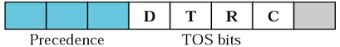
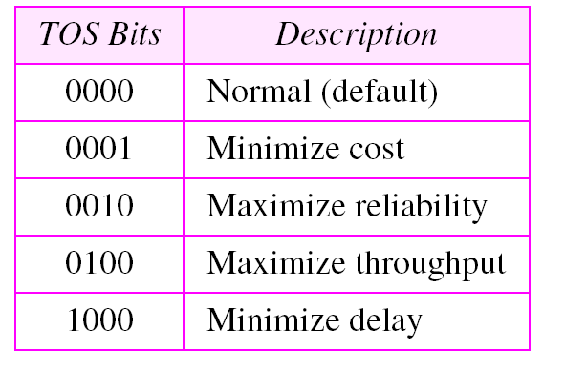
Precedence (3 Bits)– (0 to 7 i.e. 000 to 111) values were used to define assign priorities to IP packet depending on kind of Data it is carrying. In case router congestion, router will discard packets with lowest precedence value packets first.
Table 8.1 Types of service
D T R C
C- Cost
R- Reliability
T- Throughput
D- Delay
Notes:
Precedence (3 Bits)– (0 to 7) values were used to define assign priorities to IP packet depending on kind of Data it is carrying. In case router congestion, router will discard packets with lowest precedence value packets first. D T R C

Slide 16
Note:
The precedence subfield was designed, but never used in version 4.

Slide 17
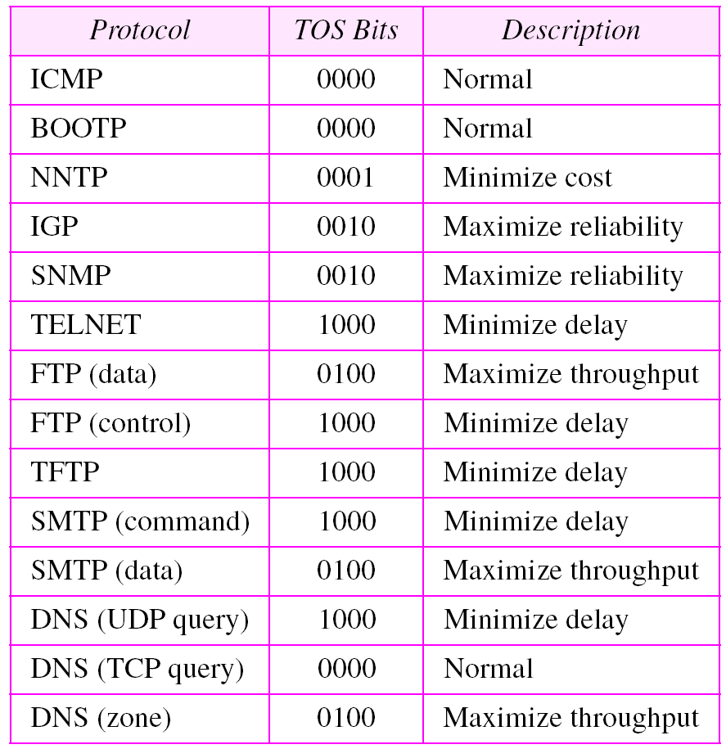
Table 8.2 Default types of service
Notes:
IGP- Interior Gateway Protocol

Slide 18
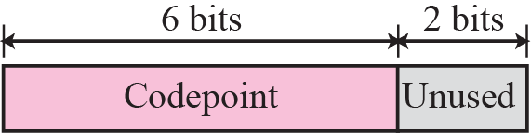
Figure 7.3 Service type
TOS- The field was used to define the precedence of the datagram; the rest defined the type of service (low delay, high throughput, and so on).
IETF changed it to Differentiated Service
a. When the 3 right-most bits are 0s, the 3 left-most bits are interpreted the same as the precedence bits in the service type(TOS) interpretation.
Notes:
Differentiated Services Code Point-DSCP- indicate a particular treatment, sometimes reflecting the Quality of Service needs of an application to the network. The DSCP informs a router how to queue packets while they are waiting to be forwarded).
DiffServ is a coarse-grained, class-based mechanism for traffic management. DiffServ relies on a mechanism to classify and mark packets as belonging to a specific class. DiffServ-aware routers implement per-hop behaviors (PHBs), which define the packet-forwarding properties associated with a class of traffic. Different PHBs may be defined to offer, for example, low-loss or low-latency service.
Rather than differentiating network traffic based on the requirements of an individual flow, DiffServ operates on the principle of traffic classification, placing each data packet into one of a limited number of traffic classes. Each router on the network is then configured to differentiate traffic based on its class. Each traffic class can be managed differently, ensuring preferential treatment for higher-priority traffic on the network. The premise of Diffserv is that complicated functions such as packet classification and policing can be carried out at the edge of the network by edge routers. Since no classification and policing is required in the core router, functionality there can then be kept simple. Core routers simply apply PHB treatment to packets based on their markings. PHB treatment is achieved by core routers using a combination of scheduling policy and queue management policy.
Edge Routers (ERs): located at the borders of the domain. They assign the DSCP value to each packet according to the QoS information received through the incoming network. Edge Routers (ERs): located at the borders of the domain. They assign the DSCP value to each packet according to the QoS information received through the incoming network.
Core Routers (CRs): located inside the DiffServ Domain. They forward the packets with different policies according to their DSCP values. Each traffic flow with the same DSCP value receives the same treatment inside the domain.
Traffic classes defined by the DiffServ protocol may be grouped as follows:
•Expedited Forwarding (EF): which identifies traffic with specific QoS requirements such as telephony [10].
•Assured Forwarding (AF): composed of traffic classes AF1, AF2, AF3 and AF4 [11].
•Best Effort (BE): does not assure any level of QoS.

Slide 19
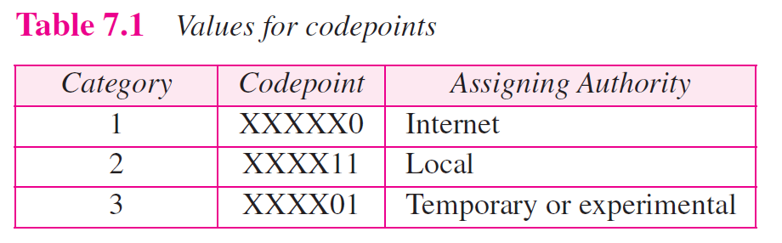
24 Category-1 Differentiated services
16 Category-2 Differentiated services
16 Category-3 Differentiated services
b. When the 3 right-most bits are not all 0s, the 6 bits define 56 (64 - 8) services based on the priority assignment by the Internet or local authorities according to Table 7.1.
Notes:
XXXXX0 –gives 32 combinations (000000,000010, 000100 000110 001000, …111110) , among these 8 code points have all right-most bits zero. 32-8=24 Category 1 Differentiated services.
This is given By 2*i where i=0,1,2,…,32
Gives 32 combinations, but exclude these 8 combinations (000000 ,001000 , 010000 , 011000 , 100000 , 101000 , 110000 , 111000 ) because all right most bits are Zero’s.
XXXX11 –Gives 16 combinations (000011, 000111, 001011, 001111, 010011, 010111, 011011, 011111, 100011, 100111, 101011, 101111, 110011, 110111, 111011, 111111)
This is given By 4*i-1 where i=1,2,3,…16
XXXX01- Gives 16 combinations (000001, 000101, 001001, 001101, 010001, 010101, 011001, 011101, 100001, 100101, 101001, 101101, 110001, 110101, 111001, 111101)
This is given By 2*i-1 where i=1, 5, 9, 13, 17, 21, 25, 29, 33, 37, 41, 45, 49, 53, 57, 61

Slide 20

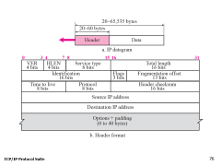
Total length field
Note
The total length field defines the total length of the datagram including the header.
Total Length= Length of Data+ Header Length
Length of Data= Total Length – Header Length
Notes:
Total length. This is a 16-bit field that defines the total length (header plus data) of
the IP datagram in bytes. To find the length of the data coming from the upper
layer, subtract the header length from the total length. The header length can be
found by multiplying the value in the HLEN field by four.
Since the field length is 16 bits, the total length of the IP datagram is limited to
65,535 (2¹⁶− 1) bytes, of which 20 to 60 bytes are the header and the rest is data
from the upper layer.

Slide 21
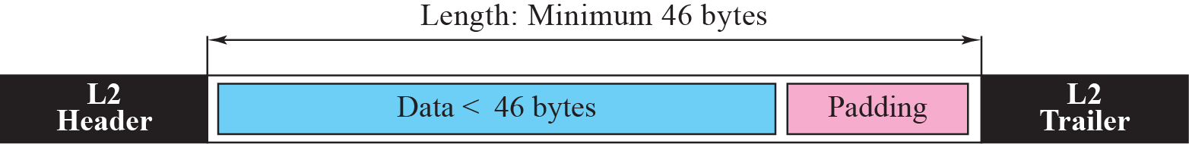
Figure 7.4 Encapsulation of a small datagram in an Ethernet frame
Total Length=Header Size+Data size
For example, if IP packet is of 40 bytes size where Header is 20 Byte + Data is 20 Byte.
If this IP packet is encapsulated in Ethernet data frame, then 6 Byte Padding is needed to fulfill min size(46Bytes) criteria of Ethernet data frame.
At the next receiving end, the total length field helps to determine how much is really data and how much is padding.
Notes:
Length of Data= Total Length – Header Length
For example, if IP packet is of 40 bytes size where Header is 20 Byte + Data is 20 Byte, then 6 Byte Padding is needed.
When a machine (router or host) receives a frame, it drops the header and the trailer leaving the datagram. Why ?
include an extra field(Total Length=Header Size+Data size) that is not needed? The answer is that in many cases we really do not need the value in this field. However, there are occasions in which the
datagram is not the only thing encapsulated in a frame; it may be that padding has
been added. For example, the Ethernet protocol has a minimum and maximum
restriction on the size of data that can be encapsulated in a frame (46 to 1500 bytes).
If the size of an IP datagram is less than 46 bytes, some padding will be added to
meet this requirement. In this case, when a machine decapsulates the datagram, it
needs to check the total length field to determine how much is really data and how
much is padding

Slide 22
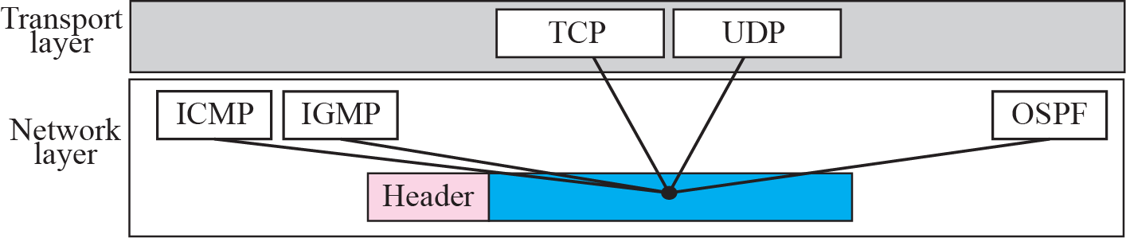
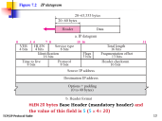
Figure 7.5 Multiplexing
Protocol field
8-bit field
Using protocol filed, IP layer decides the delivery of the packet to the other protocols that uses the services of the IP layer.
Using this filed IP layer(at Destination) has to decide to which protocol(e.g. TCP/UDP) in the higher-layer (e.g. transport) IP packet is to be delivered.
Notes:
Protocol field: This 8-bit field defines the higher-level protocol that uses the services of
the IP layer. An IP datagram can encapsulate data from several higher level protocols
such as TCP, UDP, ICMP, and IGMP. This field specifies the final destination
protocol to which the IP datagram should be delivered. In other words, since the
IP protocol multiplexes and demultiplexes data from different higher-level protocols,
the value of this field helps in the demultiplexing process when the datagram
arrives at its final destination.
OSPF- Open Shortest Path First routing Protocol

Slide 23
C:\Windows\System32\drivers\etc\Protocol file in windows 10 contains protocol and protocol number assigned.
This file contains the Internet protocols as defined by various # RFCs.
See http://www.iana.org/assignments/protocol-numbers

Slide 24

Time to live Field
Time to live. A datagram has a limited lifetime in its travel through an internet. This field was originally designed to hold a timestamp, which was decremented by each visited router.
On receiving packet, each router processes the datagram
i.e. decrements this number by one.
If this value after being decremented is zero, the router do not forwards by discarding the datagram.
Notes:
Why ?
This field is needed because routing tables in the Internet can become corrupted.
A datagram may travel between two or more routers for a long time without ever getting delivered to the destination host.
This field limits the lifetime of a datagram.
Another use of this field is to intentionally limit the journey of the packet. For example, if the source wants to confine the packet to the local network, it can store 1 in this field.
When the packet arrives at the first router, this value is decremented to 0, and the datagram is discarded.
The maximum number of hops that a route can take by default- 100 , but as field is 8 bits , so max value can be 255.(Cisco IOS in a Nutshell, 2nd Edition –O’REILLY)

Slide 25
Other Fields
Checksum : Every receiving Router(destination) can check the integrity of header information using this field.
Source address. This 32-bit field defines the IP address of the source. This field must remain unchanged during the time the IP datagram travels from the source host to the destination host.
Destination address. This 32-bit field defines the IP address of the destination. This field must remain unchanged during the time the IP datagram travels from the source host to the destination host.
Identification. This field is used in fragmentation
Flags. This field is used in fragmentation.
Fragmentation offset. This field is used in fragmentation
Notes:
Other Fields
Checksum : Every receiving Router(destination) can check the integrity of header information using this field. But at every Router, some fields like TTL, fragmentation offset etc. changes, therefore before sending packet to outgoing data link layer(in Router), checksum recalculation is needed.

Slide 26

Example 7.1
An IP packet has arrived with the first 8 bits as shown:
The receiver discards the packet. Why?
Solution
There is an error in this packet. The 4 left-most bits (0100) show the version, which is correct.
The next 4 bits (0010)₂=2 show the wrong header length (2 × 4 = 8). The minimum number of bytes in the header must be 20.
The packet has been corrupted in transmission.

Slide 27
Example 7.2
In an IP packet, the value of HLEN is 1000₂ in binary. How many bytes of options are being carried by this packet?
Solution
The HLEN value is 8, which means the total number of bytes in the header is 8 × 4 or 32 bytes.
The first 20 bytes are the base header,
the next 12 bytes are the options.

Slide 28
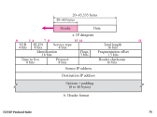
Example 7.3
In an IP packet, the value of HLEN is 5₁₆ and the value of the total length field is 0028₁₆. How many bytes of data are being carried by this packet?
Solution
The HLEN value is 5, which means the total number of bytes in the header is 5 × 4 or 20 bytes (no options).
The total length is 40 bytes (2*16¹+8*16⁰ =40) , which means the packet is carrying 20 bytes of data (40 − 20).

Slide 29
Example 7.4
An IP packet has arrived with the first few hexadecimal digits as shown below:
How many hops can this packet travel before being dropped? The data belong to what upper layer protocol?
Solution
To find the time-to-live field (9th Byte), we skip 8 bytes (16 hexadecimal digits). The time-to-live field is the ninth byte, which is 01. This means the packet can travel only one hop.
The protocol field is the next byte (02), which means that the upper layer protocol is IGMP (see Table 7.2)
Notes:
F:\MCA21\Aug-21\III Sem CN\IP header example-forouzan book.xlsx

Slide 30
An IP packet has arrived with the first few hexadecimal digits as shown below:
47 00 00 60 30 39 50 00 05 06 00 00 7D 50 30 20 B4 0E 0F 02
Identify following IP field Values-
1. HLEN
2. ToS
3. Total Length.
4. Identification field
5. Fragmentation Offset
6. Flags
7. Protocol
8. TTL
Ans: Filed values are-
1. HLEN = 28
2. ToS =000000 (Normal Priority)
3. Total Length. =96
4. Identification field =1235
5. Fragmentation Offset=4096
6. Flags =010
7. TTL=5
8. Protocol= 6
Notes:
Identify following IP field Values-

Slide 31
7-3 FRAGMENTATION
A datagram can travel through different networks. Each router decapsulates the IP datagram from the frame it receives, processes it, and then encapsulates it in another frame. The format and size of the received frame depend on the protocol used by the physical network through which the frame has just traveled. The format and size of the sent frame depend on the protocol used by the physical network through which the frame is going to travel.
Notes:
The value of the MTU differs from one physical network protocol to another. For
example, the MTU value for the Ethernet LAN is 1500 bytes(i.e. Max size of PDU(IP datagram) encapsulated in Ethernet frame, excluding 18byte frame Header)) , for FDDI LAN is 4352 bytes, and for PPP is 296 bytes.
Network-FRAMES MTU
Ethernet 1500
x.25 Minimal 576 (sending) or 1600 (receiving)^{[11]}
PPPoE v2 1492
IEEE 80.11 Wi-Fi 2304
Token Ring 4464
FDDI 4352

Slide 32
Topics Discussed in the Section
Maximum Transfer Unit (MTU)
Fields Related to Fragmentation
Notes:
FRAGMENTATION
A datagram can travel through different networks. Each router decapsulates the IP datagram
from the frame it receives, processes it, and then encapsulates it in another frame.
The format and size of the received frame depend on the protocol used by the physical
network through which the frame has just traveled. The format and size of the sent
frame depend on the protocol used by the physical network through which the frame is
going to travel. For example, if a router connects a LAN to a WAN, it receives a frame
in the LAN format and sends a frame in the WAN format.

Slide 33

Figure 7.6 MTU
Network Layer
Datalink Layer
For example, the MTU value for the Ethernet LAN is 1500 bytes (excluding 18 Byte Frame header & Trailer in case of Ethernet) ,
for FDDI LAN is 4352 bytes.
Notes:
FDDI - Fiber Distributed Data Interface (FDDI) is a standard for data transmission in a local area network. It uses optical fiber as its standard underlying physical medium
Maximum Transfer Unit (MTU)
Each data link layer protocol has its own frame format in most protocols. One of the
fields defined in the format is the maximum size of the data field. In other words, when
a datagram is encapsulated in a frame, the total size of the datagram must be less than
this maximum size, which is defined by the restrictions imposed by the hardware and
software used in the network.
The value of the MTU differs from one physical network protocol to another. For
example, the MTU value for the Ethernet LAN is 1500 bytes(i.e. Max size of PDU(IP datagram) encapsulated in Ethernet frame, excluding 18byte frame Header)) , for FDDI LAN is 4352 bytes, and for PPP is 296 bytes.
FDDI (Fiber Distributed Data Interface) is a set of ANSI and ISO standards for data transmission on fiber optic lines in a local area network (LAN)
In order to make the IP protocol independent of the physical network, the designers
decided to make the maximum length of the IP datagram equal to 65,535 bytes. This
makes transmission more efficient if we use a protocol with an MTU of this size. However,
for other physical networks, we must divide the datagram to make it possible to
pass through these networks. This is called fragmentation.
The source usually does not fragment the IP packet. The transport layer will instead segment the data into a size that can be accommodated by IP and the data link layer in use.

Slide 34
Note
Only data in a datagram is fragmented.
The reassembly of the datagram, however, is done only by the destination host because each fragment becomes an independent datagram.
Why Reassembly not done at Router?
When an IP packet is fragmented, flags, fragmentation offset, and total length fields changes & rest of the fields must be copied. Checksum recalculation needed.
Notes:
The source usually does not fragment the IP packet. The transport layer will
instead segment the data into a size that can be accommodated by IP and the data link
layer in use.
When a datagram is fragmented, each fragment has its own header with most of
the fields repeated, but some changed. A fragmented datagram may itself be fragmented
if it encounters a network with an even smaller MTU.
When a datagram is fragmented, required parts of the header must be copied by all
fragments.
The host or router that fragments a datagram must change the values of three fields:
flags, fragmentation offset, and total length. The rest of the fields must be copied. Of
course, the value of the checksum must be recalculated regardless of fragmentation.
Why Reassembly not done at Router?
The fragmented datagram can travel through different routes, and we can never control or guarantee which route a fragmented datagram may take, all of the fragments belonging to the same datagram
should finally arrive at the destination host. So it is logical to do the reassembly at the final destination.
When a packet is fragmented, each fragment may go a different path. This means that not all fragments visit all routers. In other words, a router may not have all fragments belonging to the same packet to reassemble them. The only place that all fragments eventually arrive (if not lost) is the destination host.
Even if we fix all fragments to follow a path and in intermediate path if we are trying to reassemble and forward, it may result into processing overhead(hence delay) at router (R1) and in next router(r2) which receives say assembled IP (from R1) may do fragmentation again. Results multiple times reassembly simple introduces delays at each router.
Why Reassembly not done at Router? – more overhead on Routers and possible that the datagram may undergo fragmentation again afterwards while traveling through other routers.

Slide 35
Identification Field
This 16-bit field identifies a datagram originating from the source.
The combination of the identification and source IP address must unique.
IP protocol uses a counter to label the datagrams. The counter is initialized to a positive number.
Copies the Current Label value to Identification field and increments by 1. When a datagram is fragmented, the value in the identification field is copied into all fragments .
All fragments (by fragmenting original datagram from Source) originated from original datagram will have the same identification number, same as the original datagram.
The identification number & fragmentation offset helps the Destination in reassembling the fragmented datagram into Original Datagram(sent by Source).
Notes:
Identification. This 16-bit field identifies a datagram originating from the source
host. The combination of the identification and source IP address must uniquely.
To guarantee uniqueness, the IP protocol uses one counter to label the datagrams. The counter is initialized to a positive number.
When the IP protocol sends a datagram, it copies the current value of the counter to the identification field and increments the counter by one.
When a datagram is fragmented, the value in the identification field is copied into all fragments. In
other words, all fragments have the same identification number, which is also the
same as the original datagram. The identification number helps the destination in
reassembling the datagram. It knows that all fragments having the same identification
value should be assembled into one datagram.

Slide 36
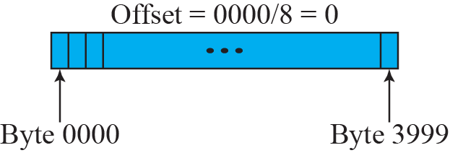
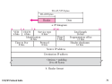
Figure 7.8 Fragmentation example
Fragmentation offset field:
This 13-bit Fragmentation offset field shows the relative position of this fragment with respect to the whole datagram.
The offset is measured in units of 8 bytes.
length of the offset field is only 13 bits long and cannot represent a sequence of bytes greater than 8191 (2¹³=8192) .
This forces hosts or routers that fragment datagrams to choose the size of each fragment so that the first byte number is divisible by 8.
Notes:
Why divisible by 8?
Offset field size 13 bits; 2¹³= 8192 max value that can be stored in Offset filed.
Min size of a fragment =Max size of IP/8192 =65536/8192 =8 bytes , means fragment size has to be 8 byte or multiples of 8 bytes.
Initial offset zero
i.e. if we represent all 8192 fragments then –
1st fragment offset -0 (0 -7 bytes)
2nd fragment offset -1(8 -15 bytes)
3rd fragment offset -2 (16 -23 bytes)
4th fragment offset – 3 ( 24-31 byte)
……………….
8192th fragment offset -8191 (65528-65535)
How to Fragment?
Assume MTU is 1420 Bytes .
The MTU of outgoing N/w is say M=1420 Bytes, fragment is created (with 20 Byte IP header + data) with size M=1420. If x is the data size in fragment(assuming no Options in header) , x+20 is IP packet size which must pass through Network with MTU M; x+20=M , so x= M-20 =1420-20=1400
x=1420-20 =1400
IP datagram size is 4020 (including Base Header 20 only, assuming no Options in header), so Data is 4000 bytes i,e, byte numbers 0 to 3999 . ,
Therefore data is T= 4000 bytes to be fragmented.
No of Fragments= (Total Data size)/(Size of data in fragment) i.e. T/x is the number of Fragments created.
T/x is the number of Fragments created. Means 4000/1400 =Upper-Bound(2.85..) , means 3 fragments.
Both 1st & 2nd fragments(data) each of 1400 and remaining 4000-2800=1200(data) in 3rd Fragment.
Fragmentation offset. This 13-bit field shows the relative position of this
fragment with respect to the whole datagram. It is the offset of the data in the original
datagram measured in units of 8 bytes. Figure 7.8 shows a datagram with a
data size of 4000 bytes fragmented into three fragments. The bytes in the original
datagram are numbered 0 to 3999. The first fragment carries bytes 0 to 1399. The
offset for this datagram is 0/8 = 0.
The second fragment carries bytes 1400 to 2799;
the offset value for this fragment is 1400/8 = 175. Finally, the third fragment
carries bytes 2800 to 3999. The offset value for this fragment is 2800/8 = 350.
Remember that the value of the offset is measured in units of 8 bytes. This is done
because the length of the offset field is only 13 bits long and cannot represent a
Offset value greater than 8191. This forces hosts or routers that fragment
datagrams to choose the size of each fragment so that the first byte number is divisible
by 8.
Offset is 13 bit size, max size representable is ; 2¹³ =8192, as offsets start from 0 , last offset number can be 8191.
8* 8191 =65528 will be the starting byte number of last fragment.
8* 8192 =65536th byte, but last byte of any IP is 65535 (Max IP length is 65535).
Therefore Offset number may be at the max equal to 8191, can’t be more than 8191
Example: if we take byte number say 13,949 which is not divisible by 8 then offset value 1743.625
If we try to represent 1743.625 in binary under 13 bits Identification field we get 11011001111.101 which exceeds 13 bits also floating value can’t be interpreted.

Slide 37
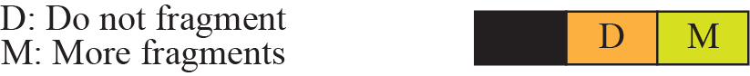
Figure 7.7 Flags field
Flags. This is a 3-bit field.
first bit is reserved (not used).
The second bit- D
If its value is 1, the machine must not fragment
If its value is 0, the datagram can be fragmented if necessary.
The third bit- M
If its value is 1, it means (more fragments) the datagram is not the last fragment (it may be any of 1st to last but One)
If its value is 0, it means this is the last or one & only fragment.
Notes:
Flags. This is a three-bit field.
The first bit is reserved (not used).
The second bit is called the do not fragment bit. If its value is 1, the machine must not fragment the
datagram. If it cannot pass the datagram through any available physical network, it
discards the datagram and sends an ICMP error message to the source host.
If its value is 0, the datagram can be fragmented if necessary.
The third bit is called the more fragment bit. If its value is 1, it means the datagram is not the
last fragment; there are more fragments after this one. If its value is 0, it means this
is the last or only fragment.
https://www.summit360.com/2019/01/18/best-ways-to-avoid-ip-fragmentation/
Avoiding IP Fragmentation Attacks
In addition to causing network inefficiencies and performance issues, IP fragmentation can lead to security issues as well. IP fragmentation attacks are a form of DDoS attack where the fragmentation mechanisms overwhelm the target network.
There are two known ways that fragmentation can be exploited.
UDP and ICMP Fragmentation Attacks
This type of attack sends fraudulent UDP or ICMP packets that exceed the MTU of the network. Since the packets aren’t real, they can’t be reassembled, but the network will continue to retransmit them. This overwhelms the server and may take it out altogether.
TCP Fragmentation Attacks
The best-known form of this attack is the Teardrop attack, which exploited a vulnerability in old versions of Windows. These kinds of fragmentation attacks target TCP/IP reassembly mechanisms by preventing them from putting fragmented packets together. Data packets begin to overlap and overwhelm the server, which can cause it to fail.
You can protect your network from these kinds of attacks by setting fragmentation rules and inspecting incoming data packets for things that violate those rules, like using a router or a secured proxy

Slide 38
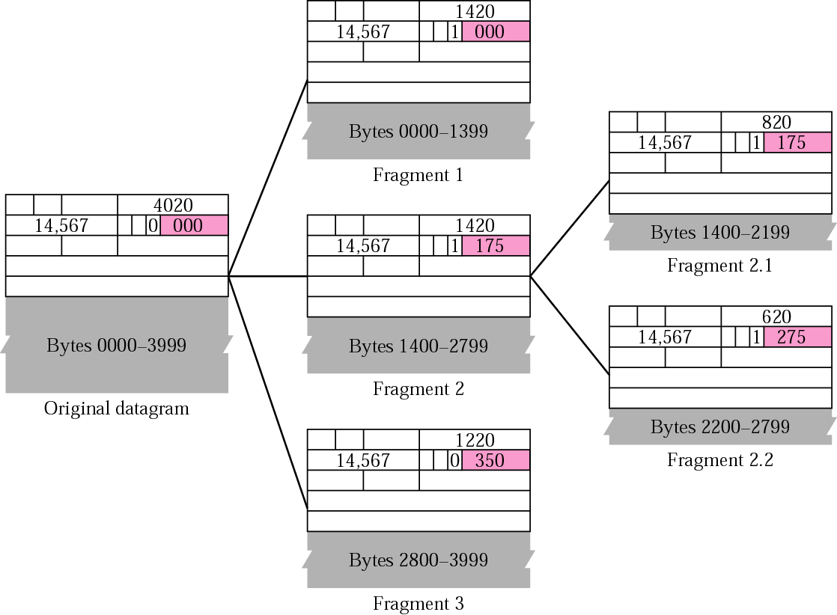
Detailed fragmentation example
Assume MTU is 1420
Assume MTU is 820
The identification field is the same in all fragments.
The value of the flags field with the more bit (M=1) set for all fragments except the last (M=0).
Notes:
Assume MTU is 1420
How to Fragment?
Assume MTU is 1420 Bytes
Assume IP datagram size is 4020 (including Base Header 20 only, assuming no Options in header), so Data is 4000 bytes i.e. byte numbers 0 to 3999 . , Therefore data is T= 4000 bytes to be fragmented.
Assume if MTU of outgoing N/w is say ‘M’ Bytes, fragment is created (with 20 Byte IP header + data) with size M. If x is the data size in fragment(assuming no Options in header) , x+20 is IP packet size which must pass through Network with MTU M; x+20=M , so x= M-20
x=1420-20 =1400
(Total Data size)/(Size of data in fragment) i.e. T/x is the number of Fragments created. Means 4000/1400 =upper-bound( 2.85..) , means 3 fragments.
Both 1st & 2nd fragments(data) each of 1400 and remaining 4000-2800=1200(data) in 3rd Fragment.
Fragmentation offset. This 13-bit field shows the relative position of this
fragment with respect to the whole datagram. It is the offset of the data in the original
datagram measured in units of 8 bytes. Figure 7.8 shows a datagram with a
data size of 4000 bytes fragmented into three fragments. The bytes in the original
datagram are numbered 0 to 3999. The first fragment carries bytes 0 to 1399.
The offset for this datagram is 0/8 = 0.
The second fragment carries bytes 1400 to 2799;
the offset value for this fragment is 1400/8 = 175. (if you select wrong byte number, example instead of 1399 1398, (0-1398)means length is 1399 not divisible by 8.
In any case if you found length of fragment according to MTU) is not divisible by 8 ,then select a largest multiple of 8 but less than (MTU-Header)(More details see in the example explained at end of this notes)
Finally, the third fragment carries bytes 2800 to 3999. The offset value for this fragment is 2800/8 = 350.
Remember that the value of the offset is measured in units of 8 bytes. This is done
because the length of the offset field is only 13 bits long and cannot represent a
Offset value greater than 8191. This forces hosts or routers that fragment
datagrams to choose the size of each fragment so that the first byte number is divisible
by 8.
Offset is 13 bit size, max size representable is ; 2¹³ =8192, as offsets start from 0 , last offset number can be 8191.
8* 8191 =65528 will be the starting byte number of last fragment.
8* 8192 =65536th byte, but last byte of any IP is 65535(0 to 65535) (Max IP length is 65536).
Therefore Offset number may be at the max equal to 8191, can’t be more than 8191
For example- Assume that an IP with payload(data part) of 1000 Bytes is to be passed through a network of MTU 512 Bytes. Every fragmented data part has IP header part(assume 20 byte mandatory header) , so in fragment data part is 512-20=492.
Number of fragments= 1000/492 =2.0325.
If we allow each fragment of length 492 bytes , then Offset value will be 492/8 =61.5 , fractional values are no allowed in offset , because it has to be multiple of 8.
Largest multiple of 8 but less than 492 is 488 byte. Therefore now fragments are 1000/488 =2.049. Means 2 fragments each of 488 data part and remaining 24 Bytes in the 3rd fragment)

Slide 39
Reassembly Strategy
Assume we have all 4 of fragments having Identification field say :-14567 (previous example)
Final destination host can reassemble the original datagram from the fragments received (if none of them is lost) using the following strategy:
a. The first fragment has an offset field value of zero. Also check M=1 or 0
b. Divide the data length of the first fragment (1399-0+1=1400) by 8 to get offset value of 2nd fragment.
The second fragment has an offset value equal (1400/8=175) to that
result. Fragment with Identification field 14567 & offset 175 is 2nd fragment
Also check M=1 or 0
c. Divide the total length of the first (1400) + second fragment (800) by 8. The third fragment has an offset value equal ((1400+800)/8=275) to that result.
Fragment with Identification field 14567 & offset 275 is 3rd fragment
d. Continue the process. The last fragment has a more bit (M) value of 0.
Notes:
Assume we have 5 of fragments having Identification number say -14567(previous example)
Discuss Fragmentation Reassembly method at receiver end.
4th fragment offset is found by adding length of all 3 fragments & dividing by 8
1400+800+600=2800 ; 2800/8= 350.
4th fragment is one which is having fragmentation offset =375 & this fragment is also having M bit 0, whch means it is last fragment.

Slide 40
Example 7.5
A packet has arrived with an M bit value of 0. Is this the first fragment, the last fragment, or a middle fragment? Do we know if the packet was fragmented?
Solution
If the M bit is 0, it means that there are no more fragments; the fragment is the last one or only one. However, we cannot say if the original packet was fragmented or not.
Notes:
A non-fragmented packet is considered the last fragment.

Slide 41
Example 7.6
A packet has arrived with an M bit value of 1. Is this the first fragment, the last fragment, or a middle fragment? Do we know if the packet was fragmented?
Solution
If the M bit is 1, it means that there is at least one more fragment.
This fragment can be the first one or a middle one, but not the last one.
We don’t know if it is the first(possible if fragmentation offset is 0-zero) one or a middle(middle means any where 2nd fragment to last but 1 fragment ) one; we need more information (the value of the fragmentation offset). See also the next example.

Slide 42
Example 7.7
A packet has arrived with an M bit value of 1 and a fragmentation offset value of zero. Is this the first fragment, the last fragment, or a middle fragment?
Solution
Because the M bit is 1, it is either the first fragment or a middle one. Because the offset value is 0, definitely it is the first fragment.

Slide 43
Example 7.8
A packet has arrived in which the offset value is 100. What is the number of the first byte? Do we know the number of the last byte?
Solution
To find the number of the first byte, we multiply the offset value by 8 (because offset=First_Byte of Fragment/8). This means that the first byte number is 800.
We cannot determine the number of the last byte unless we know the length of the data.

Slide 44
Example 7.9
A packet has arrived in which the offset value is 100, the value of HLEN is 5 and the value of the total length field is 100. What is the number of the first byte and the last byte?
Solution
The first byte number is 100 × 8 = 800. The total length is 100 bytes and the header length is 20 bytes (5 × 4), which means that there are 80 bytes data in this datagram. If the first byte number is 800, the last byte number must be 879.

Slide 45
Exercise
Suppose a TCP message that contains 2048 Bytes of Data and 20 bytes of TCP header is passed to IP for delivery across two network. If the network has a MTU of 1024 bytes, find the sizes of offsets of each fragments and data byte numbers in each fragment. Assume IP header is 20 byte(no options) and identification field value is 15681.
Notes:
Exercise

Slide 46
Suppose a TCP message that contains 2048 Bytes of Data and 20 bytes of TCP header is passed to IP for delivery across two network. If the network has a MTU of 1024 bytes, find the sizes of offsets of each fragments and data bye numbers in each fragment. Assume IP header is 20 byte.
Solution: IP datagram size =2048+20(TCP header)+20(IP header)=2088 Bytes.
So IP payload is 2068 bytes (i.e. excluding 20 byte IP header).
MTU is 1024, out of this 20 byte required for IP header attached to each fragments. So allowed max IP payload fragment is 1024-20=1004 bytes.
1004 is not multiple of 8 (restriction because otherwise offsets generated may be fractional values)
Largest possible multiple of 8, but less than 1004 is 1000bytes
Number of fragments = 2068/1000=2.068
Means 2 full fragments each with 1000 payload fragment and a 3rd fragment(remaining part of fragment) with 68 bytes (2068-2*1000=68)
1st fragment – 20 IP header + 1000 IP payload(fragmented) Total Length=1020 byte
Fragment byte number 0-999 , offset = 0/8=0
2nd fragment – 20 IP header + 1000 IP payload(fragmented) Total Length=1020 byte
Fragment byte number 1000-1999 , offset = 1000/8 =125
3rd fragment – 20 IP header + 68 IP payload(fragmented) Total Length= 88 byte Fragment byte number 2000-2067 offset =2000/8= 250
Homework- Draw an IP packet by filling field values corresponding to other fields like Version, HLEN, Total Length, Identification number(assume), offset, D,M bits. Maintain byte borders in the figure
Notes:
IP datagram size received is =2048+20(IP header)=2068 Bytes.
Homework- Draw an IP packet by filling field values corresponding to other fields like Version, HLEN, Total Length, Identification number(assume), offset, D,M bits.

Slide 47
7-4 OPTIONS
The header of the IP datagram is made of two parts: a fixed part and a variable part. The fixed part is 20 bytes long and was discussed in the previous section. The variable part comprises the options, which can be a maximum of 40 bytes.
Options, as the name implies, are not required for a datagram. They can be used for network testing and debugging. Although options are not a required part of the IP header, option processing is required of the IP software.

Slide 48
Topics Discussed in the Section
Format
Option Types
used for network testing and debugging
----Data(Payload)---

Slide 49
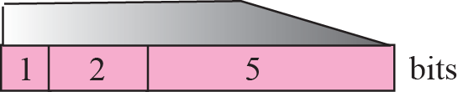
Figure 7.10 Option format
T
L
V
Length field value= length of value field(options)+ type(1-Byte) + length (1-Byte) itself
Three fields are often referred to as type-length-value or TLV
Notes:
Length- length of value , type & length itself.
Copy-0 means, while fragmenting ( most in intermediate devices like routers),along with Base header(20 Bytes) also copy options only in 1st fragments and rest of fragments will have only Base header.
Copy-1 Means all fragments carry options part too along with base header.
For example:
Timestamp option is of class Debugging & Management.
Record Route option is of class datagram Control
The next two bits define the option “class” (an option class is a grouping of
options according to their functionality). Since there are two bits, there are
four possible classes, although only two are used. Class 0 is used for network
control options, while class 2 is used for debugging services. Classes 1 and 3
are reserved for future use.

Slide 50
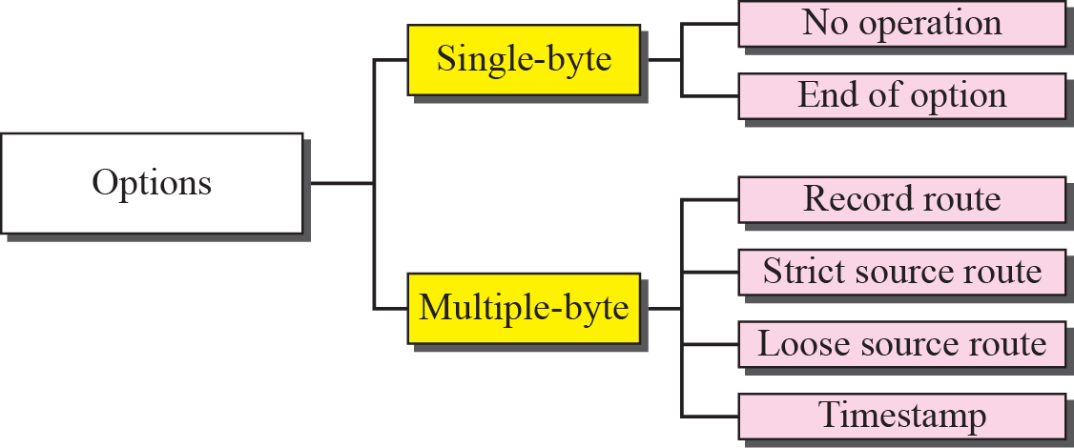
Figure 7.11 Categories of options
Single Byte Options

Slide 51
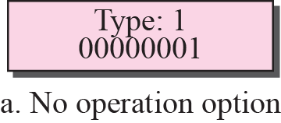
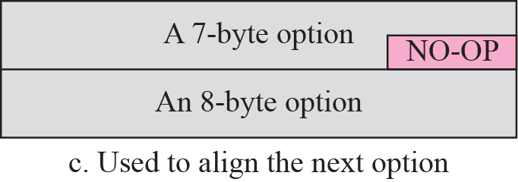
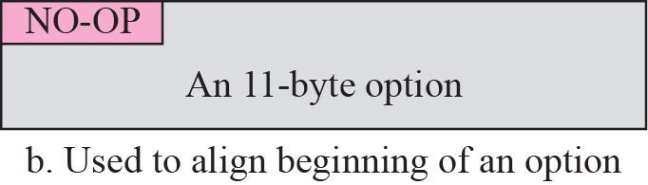
Figure 7.12 No operation option
1. no-operation option
Type | Class | Option
0 | 00 | 00001
Copy to 1st Fragment | Datagram Control | NO-Option
NO-OP – 1 byte is not counted while calculation Length filed value
Notes:
A no-operation option is a 1-byte option used as a filler between options. For example,
it can be used to align the next option on a 16-bit or 32-bit boundary.
NO-OP – 1 byte is not counted in
NO-OP and END-OP are 1-byte options, and they do not require the length or the data fields. So not counted while calculating Length filed value.
0 00 0001

Slide 52
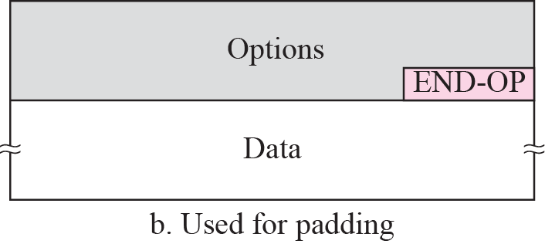
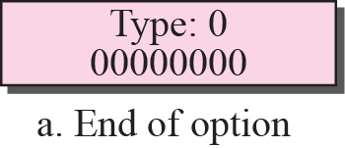
Figure 7.13 Endo-of-option option
2. end-of-option
Type | Class | Option
0 | 00 | 00000
Copy to 1st Fragment | Datagram Control | END-OP
can only be used as the last option. Only one end-of-option option can be used.
After this option, the receiver looks for the payload data.
END-OP – 1 byte is not counted while calculation Length filed value
Notes:
An end-of-option option is also a 1-byte option used for padding at the end of the
option field. It, however, can only be used as the last option. Only one end-of-option
option can be used. After this option, the receiver looks for the payload data.
This means that if more than 1 byte is needed to align the option field, some no-operation
options must be used, followed by an end-of-option option.

Slide 53
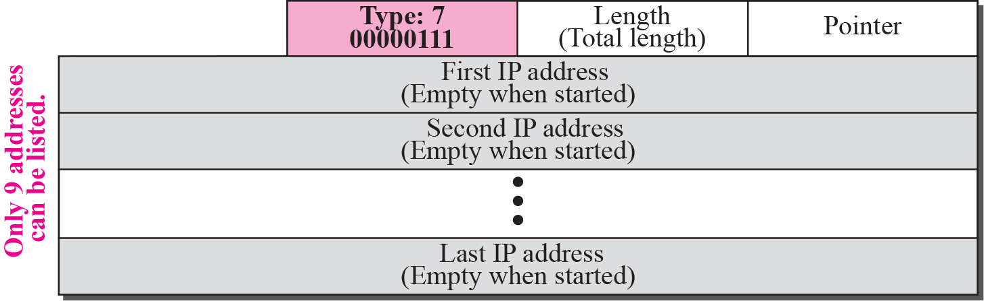
Figure 7.14 Record-route option
3. record-route option
Type | Class | Option
0 | 00 | 00111
Copy to 1st Fragment | Datagram Control | Record Route
Router inserts its outgoing IP address in the next empty field.
Value of the pointer =< Length then Entry is made
Value of Pointer > Length then No changes Made ( No space to enter)
Notes:
A record-route option is used to record the Internet routers that handle the datagram. It
can list up to nine router IP addresses since the maximum size of the header is 60 bytes,
which must include 20 bytes for the base header. This implies that only 40 bytes are left
over for the option part. The source creates placeholder fields in the option to be filled
by the visited routers. Figure
Both the code and length fields have been described above. The pointer field is an
offset integer field containing the byte number of the first empty entry. In other words,
it points to the first available entry.
The source creates empty fields for the IP addresses in the data field of the option.
When the datagram leaves the source, all of the fields are empty. The pointer field has a
value of 4, pointing to the first empty field.
When the datagram is traveling, each router that processes the datagram compares
the value of the pointer with the value of the length. If the value of the pointer is greater
than the value of the length, the option is full and no changes are made. However, if the
value of the pointer is not greater than the value of the length, the router inserts its outgoing
IP address in the next empty field (remember that a router has more than one IP
address). In this case, the router adds the IP address of its interface from which the datagram
is leaving. The router then increments the value of the pointer by 4. Figure 7.15 (next slide)
shows the entries as the datagram travels left to right from router to router.

Slide 54
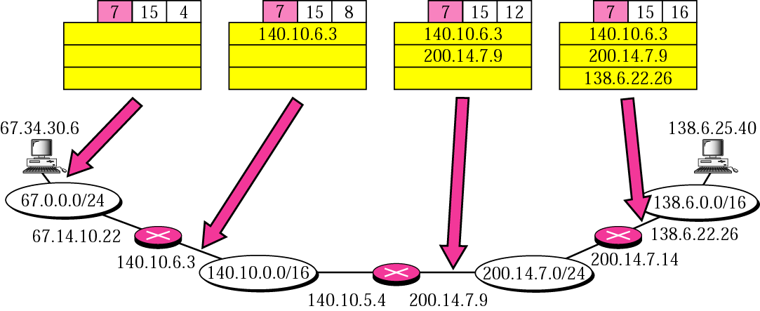
Record route concept
Records outgoing IP of Router
This option provides a means to record the route that a given packet
Notes:
Records outgoing IP of Router
Total header size 60 bytes, Base Header 20 Bytes. Available for options is 40 bytes. Each IP 4 bytes means only 9 IP entries possible.
The source creates empty fields for the IP addresses in the data field of the option.
When the datagram leaves the source, all of the fields are empty. The pointer field has a
value of 4, pointing to the first empty field.
When the datagram is traveling, each router that processes the datagram compares
the value of the pointer with the value of the length. If the value of the pointer is greater
than the value of the length, the option is full and no changes are made. However, if the
value of the pointer is not greater than the value of the length, the router inserts its outgoing
IP address in the next empty field (remember that a router has more than one IP
address). In this case, the router adds the IP address of its interface from which the datagram
is leaving. The router then increments the value of the pointer by 4. above Figure 7.15
shows the entries as the datagram travels left to right from router to router.

Slide 55
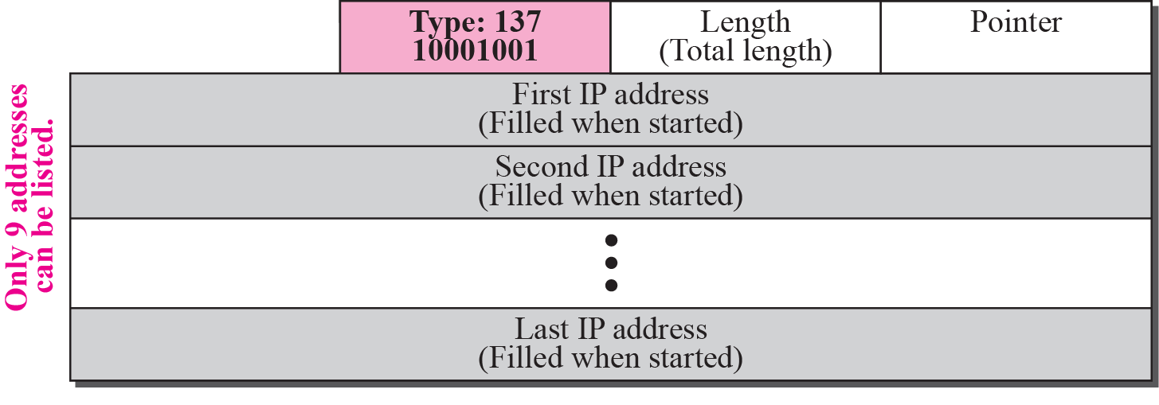
Figure 7.16 Strict-source-route option
Type | Class | Option
1 | 00 | 01001
Copy to All Fragment | Datagram Control | Strict-Source Route
4. strict-source-route option
sender can choose a route (outgoing IPs of routers) with a specific type of service, such as minimum delay or maximum throughput
Mandatory to visit all the Routers
Notes:
Why needed?
A strict-source-route option is used by the source to predetermine a route for the datagram
as it travels through the Internet. Dictation of a route by the source can be useful
for several purposes. The sender can choose a route with a specific type of service, such
as minimum delay or maximum throughput. Alternatively, it may choose a route that is
safer or more reliable for the sender’s purpose. For example, a sender can choose a
route so that its datagram does not travel through a competitor’s network.
The format is similar to the record route option with the exception that all of the IP
addresses are entered by the sender.
When the datagram is traveling, each router that processes the datagram compares
the value of the pointer with the value of the length. If the value of the pointer is greater
than the value of the length, the datagram has visited all of the predefined routers. The
datagram cannot travel anymore; it is discarded and an error message is created. If
the value of the pointer is not greater than the value of the length, the router compares
the destination IP address with its incoming IP address: If they are equal, it processes the
datagram, swaps the IP address pointed by the pointer with the destination address,
increments the pointer value by 4, and forwards the datagram. If they are not equal, it
discards the datagram and issues an error message.
in the option must be visited by the datagram. A router must not be visited if its IP address is not listed
in the datagram. If the datagram visits a router that is not on the list, the datagram is discarded
and an error message is issued. If the datagram arrives at the destination and some
of the entries were not visited, it will also be discarded and an error message issued.
The format is similar to the record route option with the exception that all of the IP
addresses are entered by the sender.

Slide 56
Figure 7.17 Strict-source-route option
Identifies a network path that the IP datagram must take, without exception.
Notes:
Figure 7.17 shows the actions taken by each router as a datagram travels from source to destination.
Destination 67.47.10.22 means here next hop, do not confuse with Final Destination(host) IP 138.6.25.40.
After leaving Router of your own network, 1st IP to reach (Next Hop) is 140.10.5.4 and then next hop has to be 200.14.7.14 (packet incoming interface of 3rd router) & final hop is 138.6.25.40(final Destination)
https://www.rfc-editor.org/in-notes/museum/ip-source-route-comments.txt (lso check RFC 791.)
Network Working Group J. Postel Request for Comments (RFC): DRAFT J. Reynolds ISI 1987
9.2.1.2 Routing options. IP provides a mechanism, called source routing, to supplement the gateway's independent routing decisions. This mechanism allows an upper layer protocol to influence the gateway route in which a datagram traverses. The UPL can pass a list of internet addresses, called a source route list, as one of the SEND service request parameters. Each address in the list, except for the last, is an intermediate gateway destination. The last address on the list is the final destination. The source IP module uses its normal routing mechanism to transmit the datagram to the first address in the source route list. Then the gateway IP replaces source route list entry with its own address as known in the environment into which it is forwarding the datagram. Thus, the datagram follows the source route while recording its "inverse" or recorded route.

Slide 57
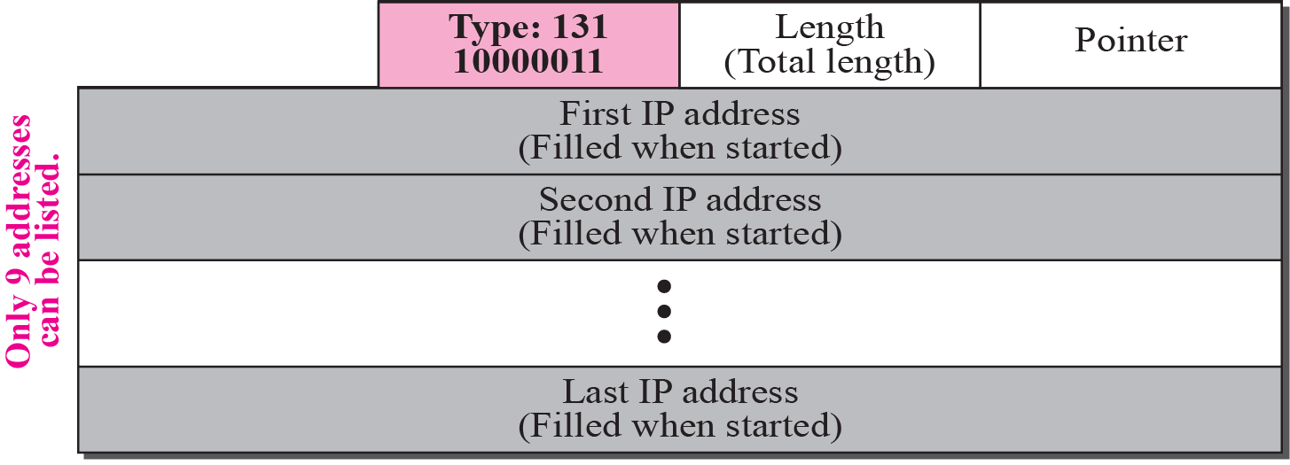
Figure 7.18 Loose-source-route option
Type | Class | Option
1 | 00 | 00011
Copy to All Fragment | Datagram Control | Loose-Source Route
Each router in the list must be visited, but the datagram can visit other routers as well
Notes:
Loose-Source-Route Option
A loose-source-route option is similar to the strict source route, but it is more relaxed.
Each router in the list must be visited, but the datagram can visit other routers as well.
Figure 7.18 shows the format of the loose source route option.

Slide 58
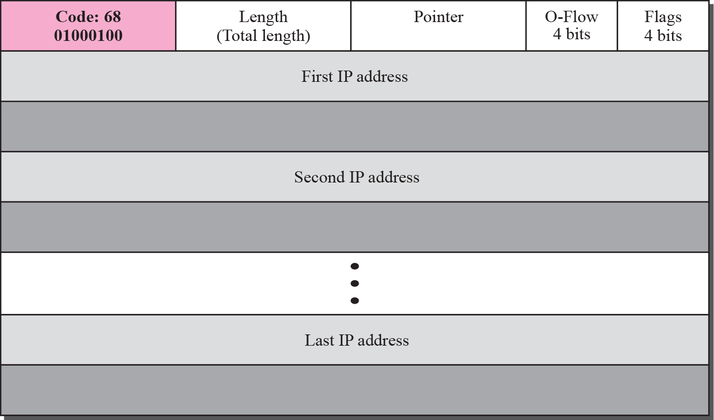
Figure 7.19 Time-stamp option
Type | Class | Option
0 | 10 | 00100
Copy to 1st Fragment | Debug & Mgmt | Time-stamp
Timestamp-expressed in milliseconds from midnight, Universal Time.
Helps managers to track the behavior of the routers in
the Internet
Notes:
Timestamp
A timestamp option is used to record the time of datagram processing by a router. The
time is expressed in milliseconds from midnight, Universal Time. Knowing the time a
datagram is processed can help users and managers track the behavior of the routers in
the Internet. We can estimate the time it takes for a datagram to go from one router to
another. We say estimate because, although all routers may use Universal Time, their
local clocks may not be synchronized.
However, non-privileged users of the Internet are not usually aware of the physical
topology of the Internet. Consequently, a timestamp option is not a choice for most
users.
In all these cases, the time is expressed in milliseconds (in a 32-bit variable) since midnight UTC of the current day.*
* UTC stands for Universal Time Clock, also called GMT (Greenwich Mean Time)

Slide 59
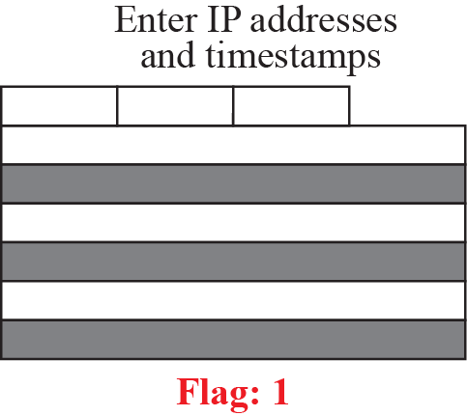
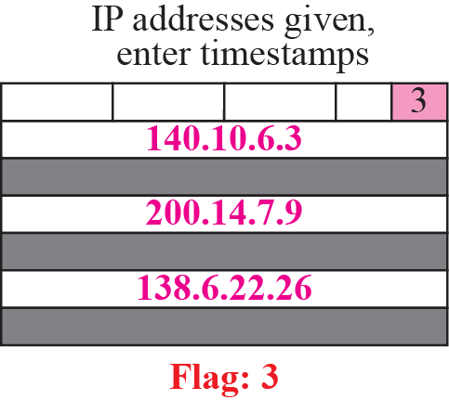
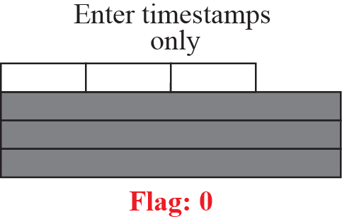
Figure 7.20 Use of flags in timestamp
O-Flow- Overflow field, records the number of routers that could not add their timestamp because no more fields were available
Flag =0, each router adds only the timestamp
Flag =1, each router must add its outgoing IP address and the timestamp
Flag=3, each router must check the given IP address with its own incoming IP address. If there is a match, the router overwrites the IP address with its outgoing IP address and adds the timestamp
Notes:
The overflow field records the number of routers that could not add their timestamp
because no more fields were available
The flags field specifies the visited router
responsibilities. If the flag value is 0, each router adds only the timestamp in the provided
field. If the flag value is 1, each router must add its outgoing IP address and the
timestamp. If the value is 3, the IP addresses are given, and each router must check
the given IP address with its own incoming IP address. If there is a match, the router
overwrites the IP address with its outgoing IP address and adds the timestamp

Slide 60
Figure 7.21 Timestamp concept

Slide 61
Example 7.10
Which of the six options must be copied to each fragment?
Solution
We look at the first (left-most) bit of the type for each option.
a. No operation: type is 00000001; not copied(only 1st)
b. End of option: type is 00000000; not copied(only 1st)
c. Record route: type is 00000111; not copied (only 1st )
d. Strict source route: type is 10001001;copied.(All fragments)
e. Loose source route: type is 10000011; copied.
f. Timestamp: type is 01000100; not copied. (only 1st )

Slide 62
Example 7.11
Which of the six options are used for datagram control and which
for debugging and managements?
Solution
We look at the second and third (left-most) bits of the type.
a. No operation: type is 00000001; datagram control.
b. End of option: type is 00000000; datagram control.
c. Record route: type is 00000111; datagram control.
d. Strict source route: type is 10001001; datagram control.
e. Loose source route: type is 10000011; datagram control.
f. Timestamp: type is 01000100; debugging and management
control.

Slide 63
7-5 CHECKSUM
The error detection method used by most TCP/IP protocols is called the checksum. The checksum protects against the corruption that may occur during the transmission of a packet. It is redundant information added to the packet. The checksum is calculated at the sender and the value obtained is sent with the packet. The receiver repeats the same calculation on the whole packet including the checksum. If the result is satisfactory, the packet is accepted; otherwise, it is rejected.

Slide 64
Topics Discussed in the Section
Checksum Calculation at the Sender
Checksum Calculation at the Receiver
Checksum in the Packet

Slide 65
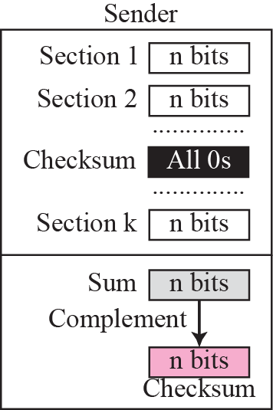
Figure 7.22 Checksum concept
N is usually 16 Bits
Uses 1’s Complement arithmetic
Notes:
N is usually 16 Bits

Slide 66
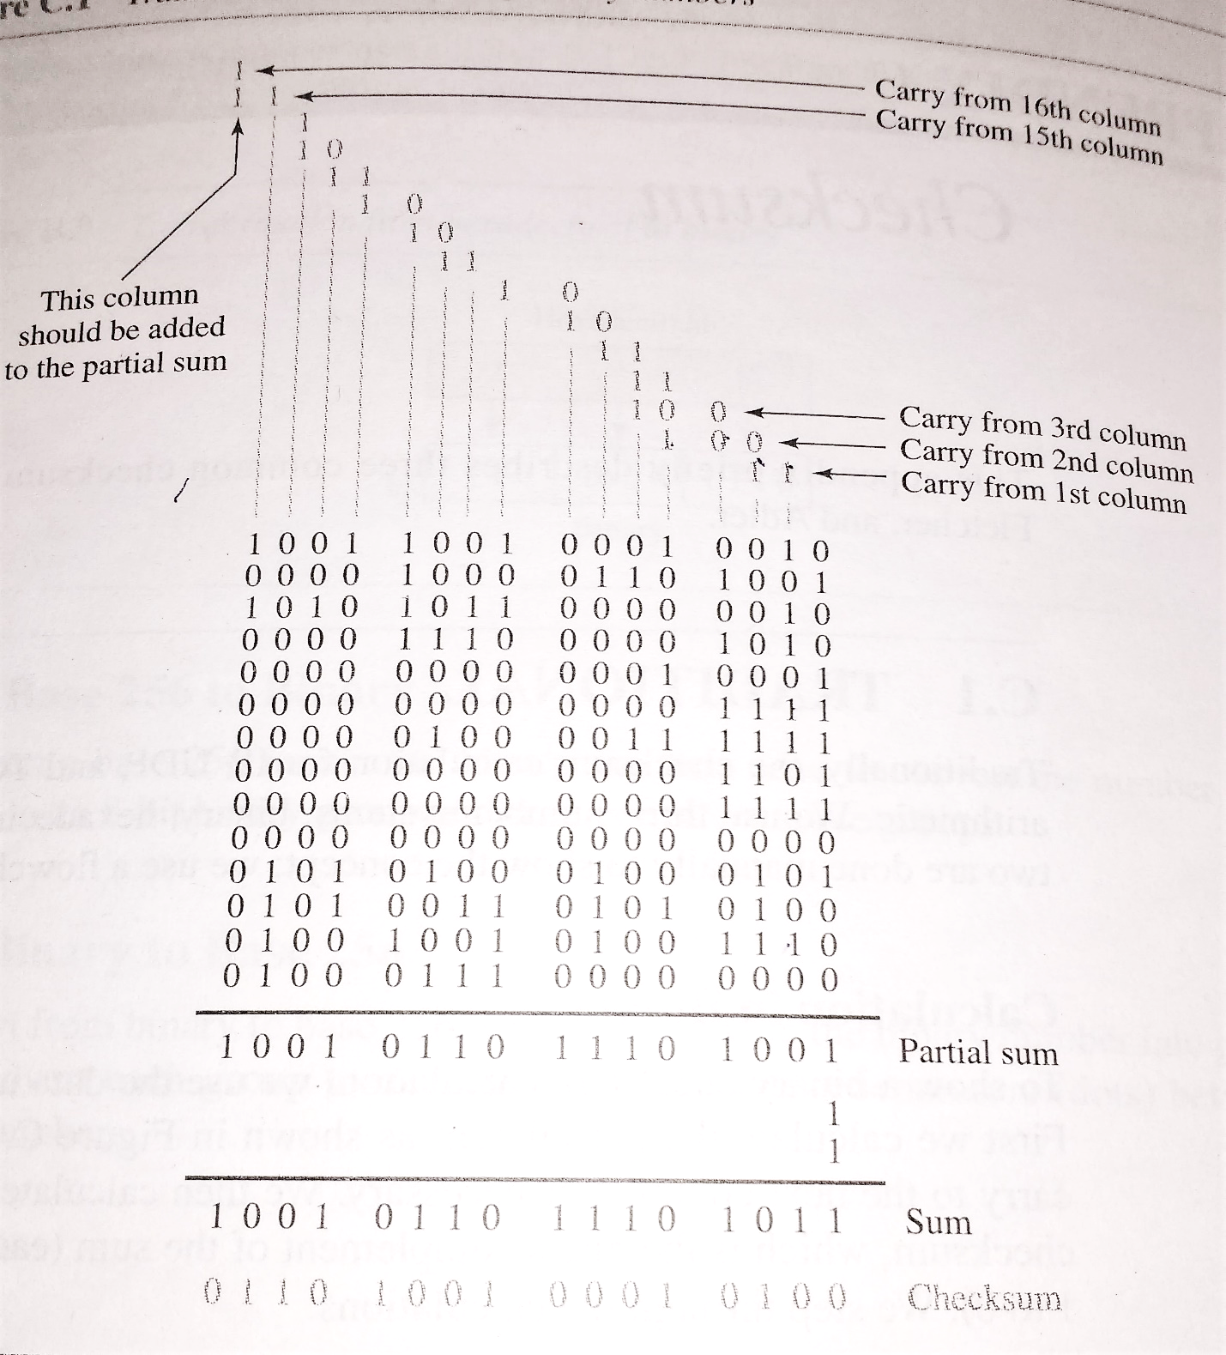
Notes:
Refer -3rd Edition Appendix C , 4th Edition Appendix D (pdf/book)

Slide 67
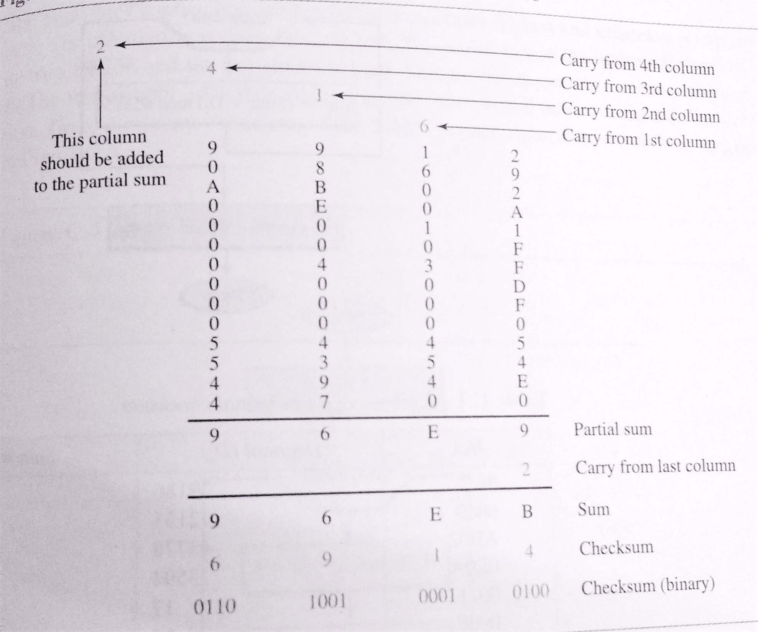
Notes:
Refer -3rd Edition Appendix C , 4th Edition Appendix D (pdf/book)

Slide 68
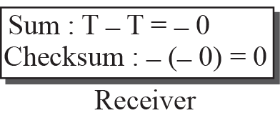
Figure 7.23 Checksum in one’s complement arithmetic

Slide 69
Note
Checksum in IP covers only the header, not the data.

Slide 70
Example 7.17
Figure 7.24 shows an example of a checksum calculation at the sender site for an IP header without options. The header is divided into 16-bit sections. All the sections are added and the sum is complemented. The result is inserted in the checksum field.

Slide 71
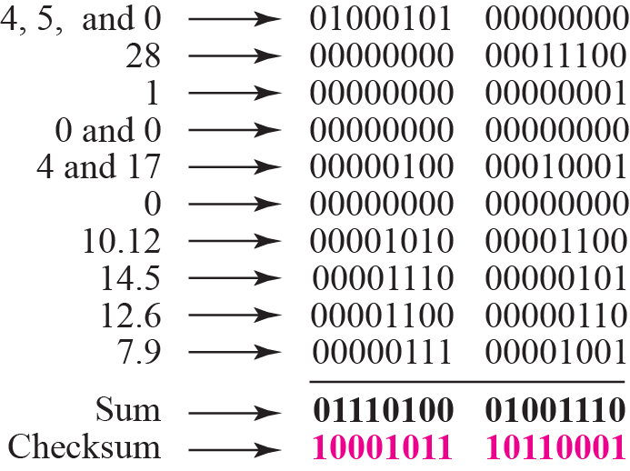
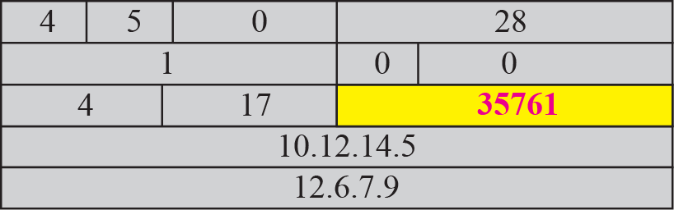
Figure 7.24 Example of checksum calculation at the sender
Each time a carry-out (17th bit) is produced, swing that bit around and add it back into the least significant bit. The sum is then one's complemented to yield the value of the IP checksum field. (Same thing in case of UDP Checksum)
Notes:
Substitute for 012.6.7.9 17015010.12.14.50028Substitute for 012.6.7.917015010.12.14.50028 Substitute for 0 Substitute for 0

Slide 72
Example 7.18
Figure 7.25 shows the checking of checksum calculation at the receiver site (or intermediate router) assuming that no errors occurred in the header. The header is divided into 16-bit sections. All the sections are added and the sum is complemented. Since the result is 16 0s, the packet is accepted.

Slide 73
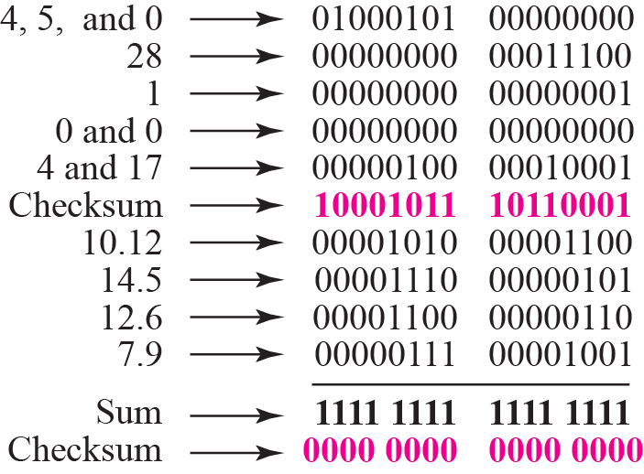
Figure 7.25 Example of checksum calculation at the receiver
After calculation , if result is 0 then IP header is intact
Notes:
After calculation , if result is 0 then IP header is intact

Slide 74
Note
Appendix D gives an algorithm for checksum calculation.

Slide 75
END of CHAPTER
Notes:
END of CHAPTER
Some Additional information in Next slides

